Slide 1
Family Law & Child Support
Presented by Tanya Wundke, Senior Lawyer
Advice, Advocacy & Assistance for People negotiating the family law & child support systems – PH: (08) 8202 5960
© 2023 Tanya Wundke & Uniting Communities Law Centre

Slide 2

Acknowledgement of Country
Notes:
We acknowledge that this land we meet on today is the traditional lands for the Kaurna people and that we respect their spiritual relationship with their country.
We also acknowledge the Kaurna people as the custodians of the greater Adelaide region and that their cultural and heritage beliefs are still as important to the living Kaurna people today.
We pay respect to Elders both past and present.
We recognise that the Aboriginal youth are the future generation to carry on Aboriginal Leaders Legacies.
We acknowledge all Aboriginal and Torres Strait Islander people Australia wide.

Slide 3


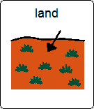



ACKNOWLEDGEMENT OF COUNTRY
We would like to acknowledge that the land we meet on today is the traditional lands for the Kaurna people

Slide 4
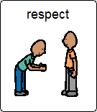

ACKNOWLEDGEMENT OF COUNTRY
and that we respect their spiritual relationship with their Country.

Slide 5

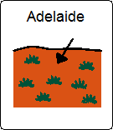
ACKNOWLEDGEMENT OF COUNTRY
We also acknowledge the Kaurna people as the traditional custodians of the Adelaide region

Slide 6



ACKNOWLEDGEMENT OF COUNTRY
and that their cultural and heritage beliefs are still as important to the living Kaurna people today.

Slide 7
What the UC Family & Child Support Team can do:
We offer all services in family law from general advice, representation and assistance in all areas of family law including but not limited to divorce, parenting matters & property settlements [Ph: (08) 8202 5960].
Child Support phone advice service = not means tested, for any and all [Ph: (08) 8202 5960]
  Link to Centrelink & FTBA = Centrelink Exemptions – Centrelink Social Workers
  Paternity matters: s106A applications
        s107 & s143 applications
  DNA testing
  COA applications = 10 reasons
  Departure applications = 10 reasons + child support debt + +18 month applications
  AAT child support proceedings
  Child Support appeals to FCFCOA
  BCSA advice
  Limited Child Support Agreements advice
  ACM applications
  Spousal maintenance applications

Slide 8
TODAY’S FOCUS
CHILD SUPPORT

Slide 9

What is Child Support?
Child Support refers to the provision of financial
support for children by parents who are no longer together.

Slide 10
Major Events
    Introduced in 1988-89
      Child Support (Registration & Collection) Act 1988 (Cth)
        Register and collect periodic payments arising from assessments, agreements and court orders;
        Mechanism to object to and seek AAT and judicial review of child support decisions.
      Child Support (Assessment) Act 1989 (Cth)
        Mathematical formula assessments
        Administrative mechanisms to change the assessment
        Child Support Agreements
      Services Australia – Child Support* administer these Acts
        Calculates the child support payment
        Collects and transfers the payments [if case = agency collect]
* Formerly the Department of Human Services – Child Support & before that the Child Support Agency

Slide 11
Should your client apply for child support??
Short answer = YES – clients are always financially better off if they receive child support + their Centrelink entitlements:
  Law of Australia = Centrelink = top up – not alternative to child support
Connection between FTBA and child support!!!
  FTBA entitlement is determined by reference to a registered child support case
  Private arrangement between parents will not be taken into account by Centrelink
  No registered child support case = risk of FTBA at minimum rate

Slide 12
When not to register a child support case [perhaps??]
If the expected recipient of child support has escaped a DV relationship
  Recipient may be able to apply to Centrelink for an exemption from “reasonable maintenance action”
  With exemption recipient will get maximum entitlement to FTBA without the necessity of a registered child support case
Things to know about Centrelink Exemptions:
  Exemptions can only be actioned by Centrelink Social Workers
  They are not necessarily permanent – whilst receiving FTBA, recipients with exemptions are ALWAYS subject to Centrelink reviewing their exemption
  Only the parent who would receive child support can apply for an exemption – a payer of child support cannot apply for exemption even if they were the victim of the DV relationship
Always best to get advice on whether or not to seek exemption

Slide 13
How to apply for a Child Support Assessment
Online - https://www.servicesaustralia.gov.au/how-to-apply-for-child-support-assessment?context=21911
  Tips & Traps
    Receipt Number – issued early with no acknowledgment of successful application
    Will time out if applicant does not have all the info required and leaves for a few minutes
Telephone – Call Services Australia – Child Support on 131 272 [Yes they can do over phone]
No paper application – unless you are TW…. [I have copies]
However the application is made have the following info:
  Applicant’s name and contact details
  Other parent’s name and contact details [as much as you have]
  Names, dates of birth and where each of the children under 18 were born
  The care arrangements for the children [nights of care]
  Bank account details for “agency” collect case [BSB, Acc No, Acc Name, Banking Institution]
If your client has little or no info on the other parent… send them to UC
PH 8202 5960

Slide 14
What if your client’s Application is refused
Short answer = send them to UC – PH 8202 5960
Your client’s application for an administrative assessment of child support may be refused:
  Not enough information re the other parent [contact info; name, DOB]
  No POP [proof of parentage]
    Other parent’s name is not on BC of child/ren
    No other proof that the other parent is the parent
  Your client is not an eligible parent [eligible parent is one who has at least shared care = 35% or more]

Slide 15
Can non-parents apply for a child support case?
Short answer is YES
May be another relative of child/ren or someone else [but not if under Youth Court order]
Registrar has to make a threshold decision regarding breakdown of family relationship such that child/ren are now being cared for by person/s other than their parents
If answer is yes then non-parent eligible to receive child support from both parents
Application is made against both parents
Can opt for “agency collect” or “private collect” case or combination of the 2
Different application form
Non-parent carers do not have to take “reasonable maintenance action” to maintain their FTBA entitlement
This can be a bit tricky – so if in doubt send the client for advice to UC
PH 8202 5960-

Slide 16
Info used to create a Child Support Assessment
ATI [Adjusted Taxable Incomes of both parents]
Self supporter amount [2023 $27,508]
Further deductions due to multi-case discount &/or relevant dependent discount
Care each parent has of each of the children
Ages of each of the children – 3 costs tables:
  under 13 years
  13 years and over
  Mixed [average of under and over]

Slide 17
A NOTE ON ATI
A parent’s ATI [adjusted taxable income] is the total of the following components:
taxable income for the last relevant year of income (including overseas income if the parent is a resident of a reciprocating jurisdiction)
reportable fringe benefits total for that year of income
target foreign income for that year of income
the parent's total net investment loss for that year of income
the total of the specified tax free pensions or benefits received in that year of income, and
the parent's reportable superannuation contributions.
Child Support Guide 2.4.4.10
NOTE: Services Australia – Child Support use adjusted taxable incomes; a taxable income may simply be the starting point for the calculation of an adjusted taxable income for child support purposes.

Slide 18
A NOTE ON CARE & CHILD SUPPORT ASSESSMENTS
The more care a paying parent has the less their child support liability [well mostly]:
0-51 nights per annum [0-13.9%]= 0 discount on child support [less than regular care]
52-127 nights per annum [14 – 34.7%]= 24% costs on Assessment [regular care]
128-237 nights per annum [35 – 64.9%] = 25-75% costs (sliding scale = the more care of the children the less child support will have to be paid) [shared care]
238-313 nights per annum [65 – 85.7%] = 76% costs on Assessment [primary care]
314 -365 nights per annum [86 – 100%] = very minimal % of child support to be paid at 86% sliding scale to nil rate closer to 100% [only if payer’s income is substantially more than payee’s income]
50/50 shared care arrangement does NOT mean no child support is to be paid
At 35% or more care a parent can apply for a % of FTBA for eligible children
FTBA is a benefit that Centrelink will split between the parents

Slide 19
How to read a Child Support Assessment
Remember:
Line up the Assessments in “Issue date” order
Line up the Assessments in “Assessment Period” order
Compare the daily, weekly, fortnightly, monthly and annual rates between Assessments
Compare the information in the “columns” between Assessments:
  Eg ATI’s, multi-case &/or relevant dependant discount
Compare the ages of the children between Assessments
Compare the care percentages of the children between Assessments
Something will have changed between Assessments to explain the change in child support amount/liability
Let’s look at one…. Next slide

Slide 21
Departure Applications
A Child Support Assessment can be changed [departed from] if the information on the Assessment is incorrect
There are 10 reasons for departure
If the child support periods for departure are within 18 months back or forward this is done by way of Change of Assessment Application [COA] aka “Application to change your assessment Special Circumstances” = administrative process through SA - CS
If the periods for departure are more than 18 months ago… then a court application is necessary
NOTE – the court cannot make orders over periods older than 7 years
The most commonly used reasons are Reasons 2, 3 and 8A = medical and dental expenses, education expenses and investigating incomes and financial resources of parents

Slide 22
Departure Applications
* Change of Assessment Applications
18 months or under or for future periods

Slide 23
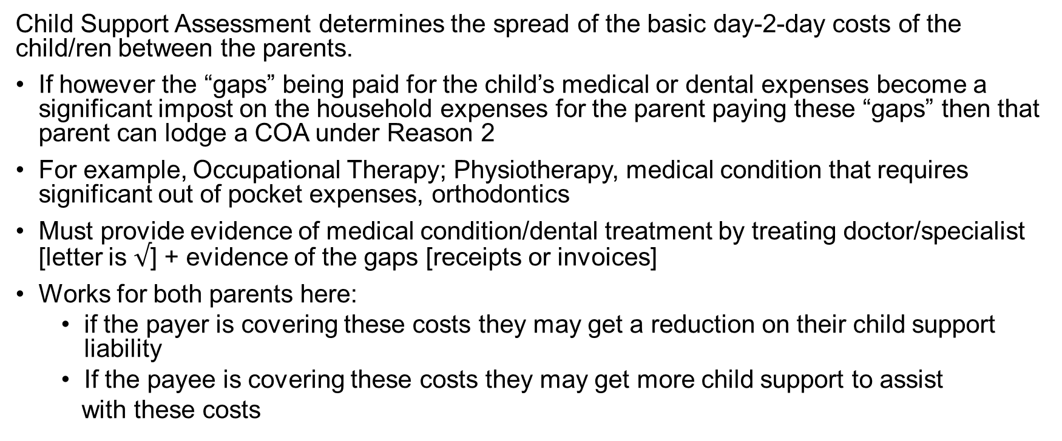
Reason 2 – Medical and dental expenses
Child Support Assessment determines the spread of the basic day-2-day costs of the child/ren between the parents.
If however the “gaps” being paid for the child’s medical or dental expenses become a significant impost on the household expenses for the parent paying these “gaps” then that parent can lodge a COA under Reason 2
For example, Occupational Therapy; Physiotherapy, medical condition that requires significant out of pocket expenses, orthodontics
Must provide evidence of medical condition/dental treatment by treating doctor/specialist [letter is $√$] + evidence of the gaps [receipts or invoices]
Works for both parents here:
  if the payer is covering these costs they may get a reduction on their child support liability
  If the payee is covering these costs they may get more child support to assist
  with these costs

Slide 24
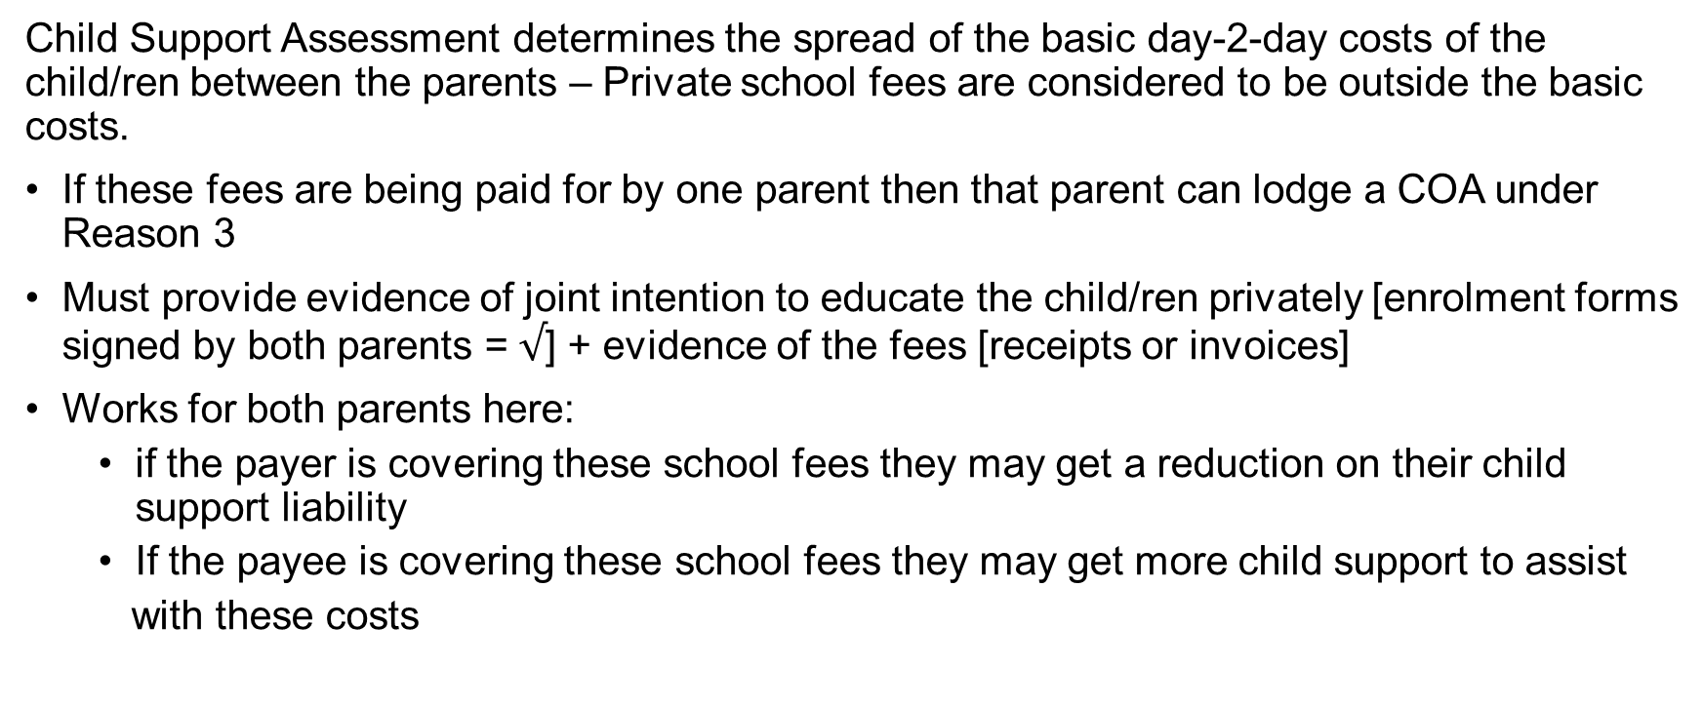
Reason 3 – Private school fees
Child Support Assessment determines the spread of the basic day-2-day costs of the child/ren between the parents – Private school fees are considered to be outside the basic costs.
If these fees are being paid for by one parent then that parent can lodge a COA under Reason 3
Must provide evidence of joint intention to educate the child/ren privately [enrolment forms signed by both parents = $√$] + evidence of the fees [receipts or invoices]
Works for both parents here:
  if the payer is covering these school fees they may get a reduction on their child support liability
  If the payee is covering these school fees they may get more child support to assist
  with these costs

Slide 25
Reason 8A – Parent’s income & financial resources
Child Support Assessment determines the spread of the basic day-2-day costs of the child/ren between the parents, taking into account each parent’s ATI.
If however, a parent’s income is incorrect or they have financial resources that are not being taken into account in the Assessment then the Assessment may be inaccurate
A parent may lodge COA under Reason 8A to have their own or the other parent’s income and financial resources investigated
If a parent has changed jobs during an Assessment period they may wish to have their income investigated and changed to accurately reflect their new income – COA is a slower but safer option than estimating their income [wrongly estimating can lead to fines being imposed once an estimated income is “reconciled” with the new ATI for that parent]
A parent can apply to have the other parent’s income and financial resources investigated if that parent believes the current Assessment does not reflect actual the income & financial resources of the other parent
Eg tradies’ incomes are often artificially low due to their legitimate tax deductions
NOTE: Fringe benefits & HELP debts & salary sacrificing & salary packaging artificially inflates ATI’s used for Child Support Assessments

Slide 26
Reason 8B – the most misunderstood reason
Reason 8B states: The assessment does not correctly reflect one or both parent’s capacity to earn an income
This reason is rarely successful
There has to have been a change in work habit since the commencement of the child support case
And this change in work cannot be due to that parent’s health, caring responsibilities or another reason unrelated to child support
The applicant needs a “smoking gun” to be successful under this reason – the applicant needs to have some evidence that the change in work has been done deliberately to manipulate the Child Support Assessment
If in doubt send the client to UC PH 8202 5960

Slide 27
What if client not happy with COA Decision
If the client is not happy with the Notice of Decision [NOD] from the COA Application – they can object to this decision within 28 days of them receiving the NOD:
28 days from the NOD lobbing into MyGov account; or
28 days from the NOD being received in their mailbox
There is a form for an Objection but not necessary to use… just needs to be in writing
Objections Officer will then look at the application again… de novo
Other evidence can also be provided for the Objection
If client not happy with the Objection decision off to the AAT they go
Appeal from AAT decision to FCFCOA on error of law ONLY
UC Law Centre is here to help PH 8202 5960

Slide 28
What if care % is wrong on the Assessment
This is one of the only things that can be done over the telephone without the necessity to fill out a form
Incorrect care percentages can often be worse than incomes being wrong on a Child Support Assessment
Ring Services Australia – Child Support on 131 272 to notify of change of care ASAP and within 21 days of that care change if possible – as no backdating
Services Australia – Child Support will confirm this care change with the other parent – if confirmed the Assessment will be changed
If not confirmed… parents will be required to provide evidence supporting their care percentage and the Registrar will have to make a decision on care of the child/ren
  2 levels of administrative decisions withing SA-CS +
  2 levels of appeal at AAT

Slide 29
What is a 106A Application
Your client has received a refusal letter from Services Australia – Child Support and has been told to seek a 106A order from the court
Normally the mum is trying to get dad signed up to pay child support for a child/ren
This order is often accompanied by a s69VA FLA order [declaration of parentage]
  That John Doe is declared to be a parent of Jane Doe, born 18 August 2022.
The 106A order is the order Services Australia – Child Support needs to commence the child support case – orders the Registrar to assess the dad for child support [start a case]
56 day rule – Applicant meant to lodge in court within 56 days of date of refusal letter [in SA our CS Judges have been very amenable to extensions of time for this application noting the work done to try to resolve the matter prior to filing]
There is more than one way to get a parent onto the CS Register – seek advice &/or ongoing assistance &/or representation from UC ASAP PH 8202 5960

Slide 30
What is a 107 application
Your client is assessed to pay child support and does not believe they are the parent of the child/ren
Normally the dad is stating they are not the parent of the child/ren
The 107 order removes the father from the child support register for that child/ren – the effect of this order on the CS Register is that it is as if the case for the child/ren never existed = raises an overpayment on the Register
56 day rule – Applicant meant to lodge in court within 56 days of date of refusal letter [again in SA our CS Judges have been amenable to extensions of time for this application noting the work done to try to resolve the matter prior to filing – this will depend upon the facts]
s107 states the court must as soon as practicable consider making a s143 order [in SA Judges been very happy to ignore a 143 order unless it is sought by Applicant !!]
s143 order is an order that the recipient of child support must pay back the child support they have received since the start date of that case for that child/ren – Registrar will collect and return to successful applicant
NOTE: not all children are equal on a CS Assessment – first child most heavily weighted – 4th & subsequent children = $0
Cannot run a 107 if the parent was put on the Register by way of 106A order [have to appeal 106A]
There is more than one way to navigate a 107 [s151 application] – these are very tricky
Ring 8202 5960

Slide 31
BCSA – does your client really want one
UC Law Centre Team will advise on pros and cons of BCSA – but will not sign Certificates… Why?
  Because I am looking at a BCSA with a view to failing it…
  I have significant reservations regarding their ability to do what parents intended & flexibility that a CS Assessment provides…
Binding Child Support Agreements are expensive & arguably easy to get into – but very difficult to get out of…
There does not need to be a case registered with Services Australia – Child Support to lodge the BCSA
BCSA is a “registrable maintenance liability”…this means the BCSA if compliant with the legislation such that is it accepted as a BCSA – can be lodged with Services Australia – Child Support – what does this mean??
  Will Services Australia – Child Support enforce the Agreement?
Let’s look at some scenarios…. Next slides

Slide 32
Scenario 1
This Agreement is and is intended by the parties to constitute a Binding Child Support Agreement pursuant to section 80C of the Act insofar as it relates to the children referred to in paragraph E of the Recitals.
This Binding Child Support Agreement complies with Section 82, Section 83 and Section 84 of the Act
That the husband shall pay child support to the wife for and on behalf of the children as follows:
  By way of periodic amounts:
    The sum assessed from time to time, by the Child Support Agency, pursuant to the Child Support (Assessment) Act.
  By way of non-periodic amounts:
    By paying 50% of the following;
      Driving lessons;
      Medical specialists’ fees;
      Special medication expenses;
      Orthodontic costs;
      Ambulance membership fees;
      School fees for Marryatville High School;
      Uniform costs;
      Music tuition fees per term;
      School photos;
  $1000 annually towards bus pass/Metro card;
  The children’s mobile telephone expenses.
In the event the wife is required to pay in the first instance for which the husband is responsible pursuant to paragraph 3 herein, the husband
shall reimburse the wife within 14 days of the expense incurred by the wife, upon provision of the appropriate tax invoice, receipt or record of payment.

Slide 33
Scenario 2
This Agreement is and is intended by the parties to constitute a Binding Child Support Agreement pursuant to section 80C of the Act insofar as it relates to the children referred to in paragraph E of the Recitals.
This Binding Child Support Agreement complies with Section 82, Section 83 and Section 84 of the Act
That the husband shall pay to the wife, in lieu of the sum assessed from time to time, by the Child Support Agency, pursuant to the Child Support (Assessment) Act
  By way of periodic amounts:
    $0.00.
  By way of non-periodic amounts:
    By payment of 100% of the following;
      Private school fees;
      All additional costs associated with the children’s private education, including but not limited to:
        Uniform costs;
        Camp and extracurricular costs;
        Music tuition fees per term;
        Building levy;
        Bus fees;
        School photos;
        Any other costs/fees/charges levied by the school from time to time.
      Private health premiums;
      Medical specialists’ fees/gap payments;
      Special medication expenses;
      Orthodontic costs/gap payments;
      Ambulance membership fees;
      Children’s extracurricular and sporting activities including but not limited to:
        Registration fees;
        Weekly playing/participation fees;
        Uniform and costume costs;
        Any non-periodic amounts levied by the children’s extracurricular activities from time to time.
      The children’s mobile telephone expenses.
In the event the wife is required to pay in the first instance for which the husband is responsible pursuant to paragraph 3 herein, the husband shall reimburse the wife within 14 days of the expense incurred by the wife, upon provision of the appropriate tax invoice, receipt or record of payment.

Slide 34
Scenario 3
This Agreement is and is intended by the parties to constitute a Binding Child Support Agreement pursuant to section 80C of the Act insofar as it relates to the children referred to in paragraph E of the Recitals.
This Binding Child Support Agreement complies with Section 82, Section 83 and Section 84 of the Act
That the husband shall pay child support to the wife for and on behalf of the children as follows:
  By way of periodic amounts:
    The sum of $300 per week per child till each child reaches their 18th birthday.
  By way of non-periodic amounts:
    By payment of 100% of the following;
      Private health premiums;
      Medical specialists’ fees/gap costs;
      Special medication expenses;
      Orthodontic costs;
      Ambulance membership fees;
      Private school fees and all associated costs, including but not limited to uniform costs, music tuition costs, building levy etc.
  $1000 annually towards bus pass/Metro card;
  The children’s mobile telephone expenses.
In the event the wife is required to pay in the first instance for which the husband is responsible pursuant to paragraph 3 herein, the husband shall reimburse the wife within 14 days of the expense incurred by the wife, upon provision of the appropriate tax invoice, receipt or record of payment.
Let’s look at this one from the payer’s/husband’s perspective:
The mother had 100% care when this was signed; now she has 35% care;
The payer loses his job and/or ends up on Centrelink benefit as his sole source of income

Slide 35
Thanks for your time today
Just remember:
Any family law enquiry that comes to you where there are children potentially has a child support issue
UC Family Law & Child Support Team are very happy to assist your clients with child support issues – clients just need to ring UC Law Centre (08) 8202 5960 to organise an initial telephone appointment
I am very happy to take calls from colleagues – this stuff is tricky and technically difficult and precise
NOTE: it is possible for clients to get an adverse decision – specialist advice is required
The Family Law & Child Support Team at UC Law Centre offer assistance and
representation for all family law and child support issues.

Slide 36



                Family Law & Child Support Service
                Visit 43 Franklin Street, Adelaide SA 5000
                Call: (08) 8202 5960
                Country callers: 1300 886 220
                Email lawcentre@unitingcommunities.org
Online www.unitingcommunities.org

Slide 37
Useful resources
The FCFCOA website offers a plethora of information and fact sheets for clients navigating the family law system: https://www.fcfcoa.gov.au/
The Guide [Guides to Social Policy Law Child Support Guide] is published and maintained by the Australian Government offers information regarding the Australian child support scheme: https://guides.dss.gov.au/child-support-guide
TW & UC Team = 8202 5960

Slide 38
Questions

